Slide 1
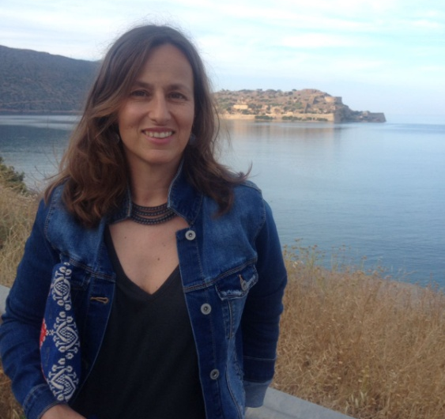
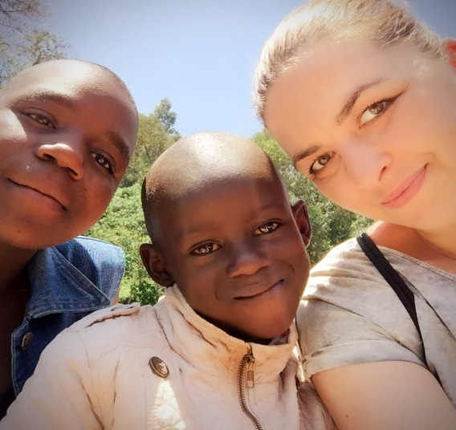
Andrea Sala- Project Manager
Supports School4Life since May 2017
Who Am I? Born and raised in Barcelona, where I completed a degree in Business Administration. Have worked and lived in several countries since then. Moved to Zurich with my family in 2008. My main line of work has been developed in the Medtech industry , lately as Business Processes Director EMEA. How do I support School4Life?
Being a Project Manager at School for Life, I support all types of projects that are currently important to further grow the organization. Assignments I have been in involved with include the communication for the Re-brand as well as looking at new streams of funding for the Special Needs School.
Why School4Life? Because Astrid’s speech at my children’s school Christmas concert moved me to tears.
My best moment with School4Life:
Meeting the team for the 1st time and enjoying good Spanish gapzpacho with Ana whilst we squezze our brains!
Karolina Letowska– PMI Project Manager / Kids Home Coordinator
Supports School4Life since November 2016
Who Am I? Born and raised in Poland, where I completed my Master degrees in 'Theory of Economics' and in 'Financial Engineering'. I have worked in various European countries since then and in 2016 I moved to Zurich. My main line of work has been in project management for the financial industry, and more recently as a Project Manager in Regulatory Implementations.
How do I support School4Life?
As a PMI Project Manager for School4Life I am responsible for the cooperation between the two organizations which includes fundraising, networking, trainings and project coordination.
As a Kids Home Coordinator my main focus lies on our children's further education.
Why School4Life?
Some children have to overcome obstacles we cannot even imagine. I want our kids to feel that despite the distance between us they have somebody who will support them.
My best moment with School4Life:
My visit to Kimilili in March 2017.

Slide 2
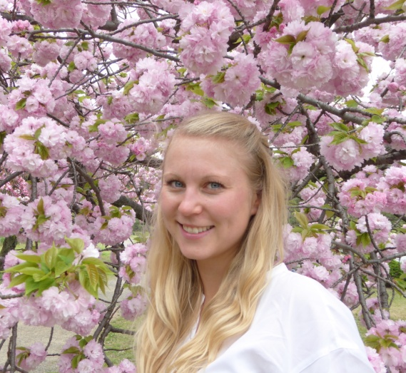
Placeholder for your picture
Emma Delmotte – French Market
Supports School4Life since May 2017
Who Am I? Born and raised in France, I completed my Master's degree in supply chain management in London and started my consulting career in the UK before I moved to Geneva, Switzerland for supply chain management consulting. My main focus is large transformation programmes and procurement at the moment.
How do I support School4Life ?
I am taking care of the French market starting with the creation of a page in French for our website.
Why School4Life? Because education for both girls and boys is the future for a better world!
My best moment with School4Life:
Meeting the team!
Platzhalter für dein Bild
Dr. Therese Triemer – Event Manager
Supports School4Life since August 2012
Who Am I? Born and raised in Germany, I finished my Master degree in Chemistry in Berlin and Oxford. I recently completed my doctoral degree in Molecular Life Sciences in Zurich and started a consulting career in the area of Life Science consulting. Besides my passion for Kimilili I love hiking, climbing, and travelling.
How do I support School4Life?
Being an Event manager for School4Life, I am responsible for organizing fundraining events, to aquire sponsors for our children in Kimilili and collect donations. I have also supported the internal functioning of School4Life. Why School4Life?
Because a happy smile of a child is one of the best presents on earth!
My best moment with School4Life:
The 5th year birthday celebration.

Slide 3
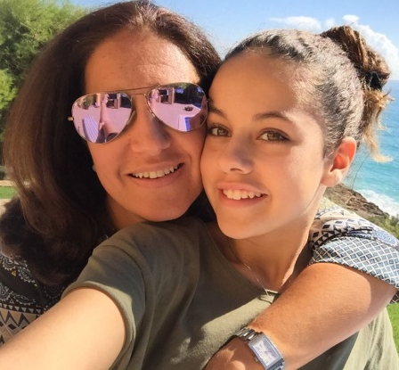
Placeholder for your picture
Ana von Bock - Project Manager
Supports School4Life since 2015
Who Am I? I was born and grown up in Sao Paulo – Brazil with a huge Spanish influence from my mother’s side. After university and post- grade in Business Administration I went to Spain to finish my studies with a MBA in Barcelona. I worked in Marketing and Business Development in Barcelona and then came with my husband to start our new adventure in Zurich where 2 kids were born. Nowadays I’m working in Finance with a passion for Social Impact investments and Corporate Social Responsibility areas.
How do I support School4Life ?
Personally I have been supporting the kids with school fundraising projects and sponsoring teachers in School4 Life.
As a Project Manager at School for Life, I will work and support the communication strategy and the grow of the Special Needs school.
Why School4Life? Because is one of the best projects I have seen lately.
My best moment with School4Life:
Meeting Agnes for the first time, 2 years ago I felt that I immediatley wanted to be part of this incredible project and help as much as kids as possible.in the region.

Slide 4
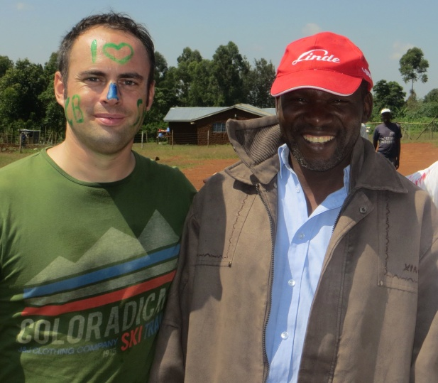
Norbert Benker– Project Manager
I support School4Life since August 2013 and I went to see the kids in Kimilili 3 times.
Who am I? After my studies of economics in Mannheim I lived 9 years in different African countries, like Congo, Uganda, Tanzania and Kenya. I worked as the COO of a micro finance bank and after traveling for a year in Africa and Latin America I started a family company in Germany.
How do I support School4Life ?
I am mainly looking after the IT solutions that enables S4L to better communicate internally and externally. I also support at fundraising events and I promote S4L as often as possible. I also adopted a child. Why School4Life? If you have visited the project, you don‘t need another WHY.
My best moment with School4Life:
The moment we announced to the finalists of the Primary School that we would open a Secondary School for them and they will be able to continue their education. You can read about their joy here! LINK Volunteer Bericht
Norbert Benker – Projekmanager
Ich unterstützte School4Life seit August 2013 und war schon drei Mal in Kimilili.
Wie unterstütze ich School4Life?
Ich kümmere mich hauptsächlich um die IT Lösungen für eine verbesserte interne und externe Kommunikation. Ich helfe ausserdem bei Spendensammlungen und vermarkte das Projekt so oft ich kann. Und ich habe ein Kind adoptiert. Warum unterstütze ich School4Life?
Wenn du das Projekt besucht hast, brauchst du kein weiteres WARUM.
Mein schönster Moment mit School4Life:
Der Moment wo den Absolventen der Primarschule mitgeteilt wurde, dass eine Sekundarschule eröffnet werden würde und sie ihre Ausbildung weiterführen können. Über ihre grenzenlose Freude kann hier mehr gelesen werden. LINK Volunteer Bericht

